Slide 1

Master Thesis
MSc in Bioinformatics and Biostatistics
scRNAseq Analysis of AML CD34⁺/CD38⁻ population with Diagnosis and Relapse paired data
Author: Joseba Elizazu Perez
Director: Juan Luís Trincado Alonso
6/06/22

Slide 2
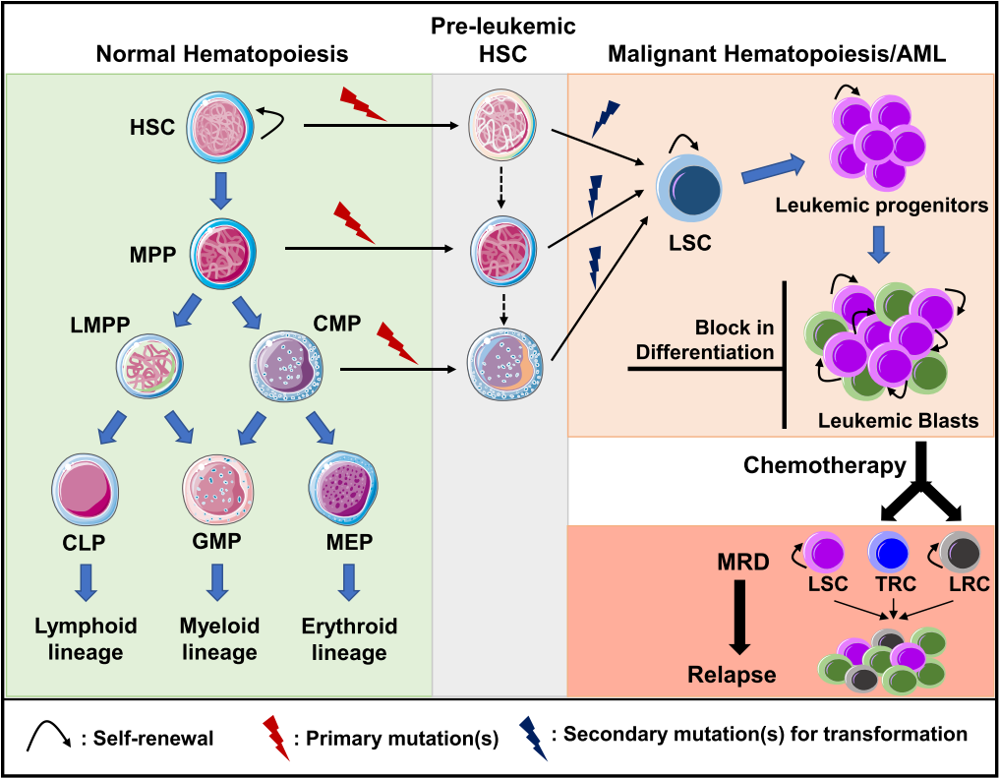
Acute Myeloid Leukemia
Accumulation of immature clonal myeloid progenitors in the BM
> 20% blasts in BM or blood
5-year survival < 30%
Relapse in 50%
The LSC model to explain leukemogenesis and relapse
LSCs reside within the CD34⁺/CD38⁻ population
Defined by functional assays
No LSC-specific markers
Figure 1: Schematic representation of normal hematopoiesis and leukemogenesis.
Long et al., 2022

Slide 3
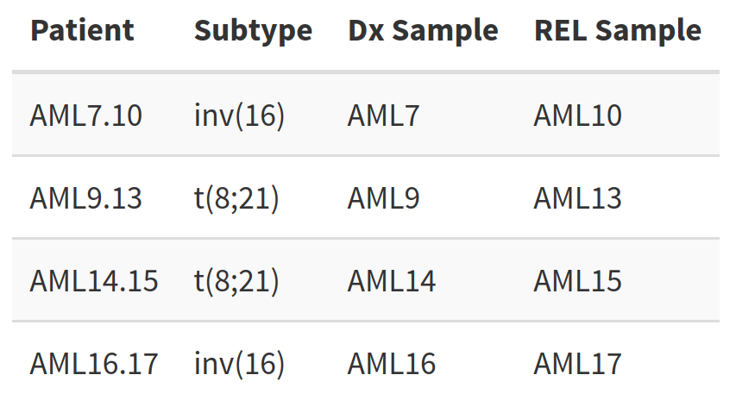
To elucidate the transcriptional landscape shift of the AML CD34⁺ /CD38⁻ population, in 8 patient- paired Dx and REL samples by scRNAseq
Table 2: Sample data summary
In three steps:
Analyze each Dx and REL data separately.
Integrate the Dx and REL datasets of each patient to characterize the clusters
Integrate the four integrated datasets and analysis

Slide 4
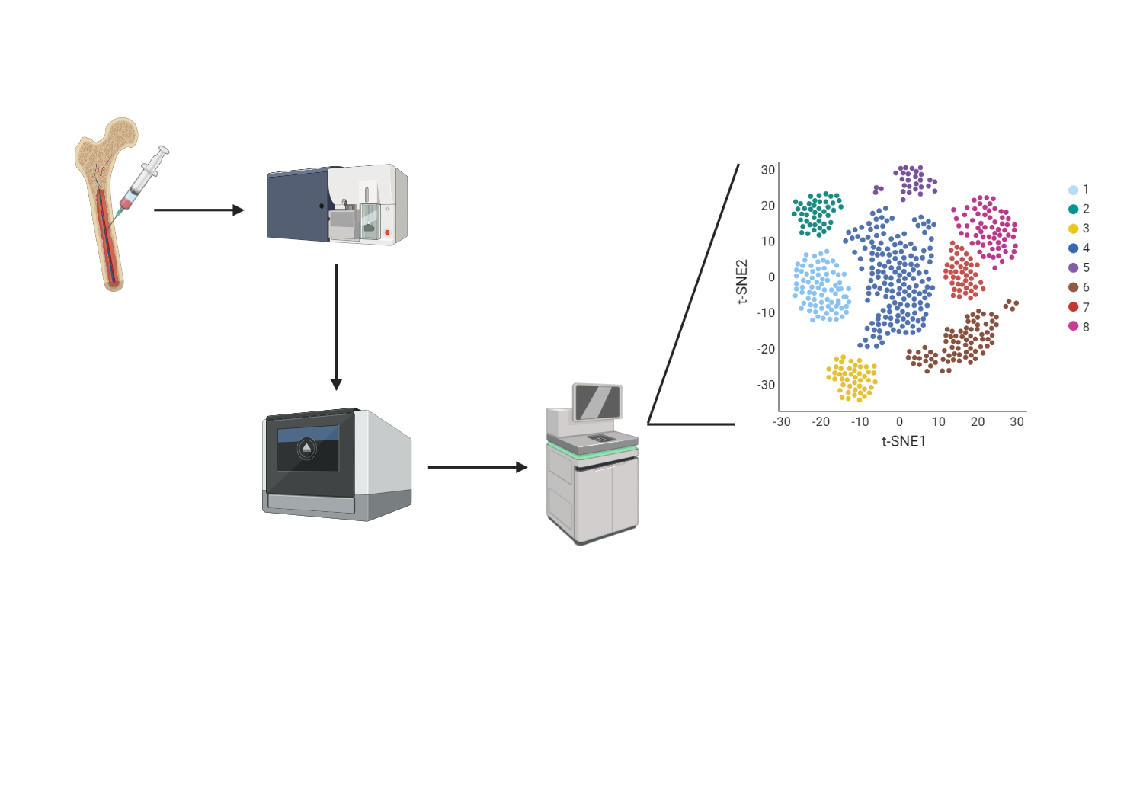
Sample Characteristics
scRNAseq data analysis
FACS
Pre-processing
(CellRanger)
CD34⁺/CD38⁻
Table 2: Sample data summary
Library preparation + sequencing
(10X Genomics, droplet-based method)

Slide 5
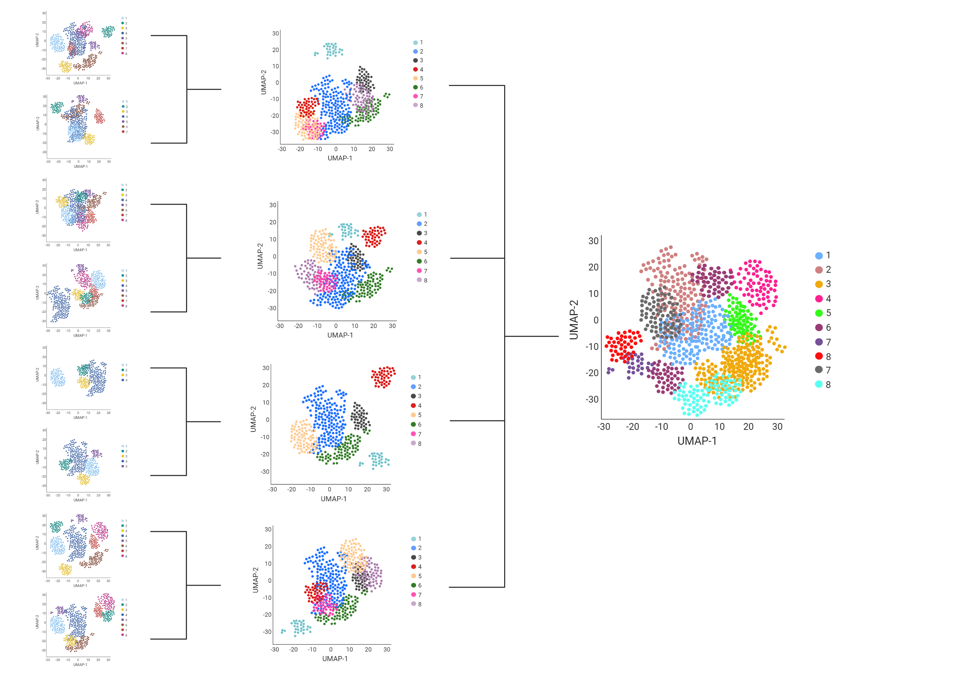
Sample Data
Patient data
Raw data
(Pre-processed)
Seurat Object
QC
Full Integration data
Normalization
Patient data
Integration
Full data
Integration
Dimensionality
reduction
Dimensionality
reduction
Dimensionality
reduction
Clustering
Clustering
Clustering
Analysis
Analysis
Analysis

Slide 6
Main Tools:
R (4.1.3 & 4.2.0)
Seurat (v4.1)
ClusterProfiler (4.4.1)
QC
By count depth
Number of genes per barcode
Counts from mitochondrial genes per barcode
Normalization:
Sctransform, regressing MT genes and with 3000 features
Dimensionality reduction
PCA, between 10-20 PCs

Slide 7
Unsupervised clustering:
Cluster stability
DEGs per cluster & top DEGs duplicated
Healthy BM cell type projections (Triana et al., 2022)
Enrichment analysis (ORA in Gene Ontology, KEGG and Reactome)
Integration: 3000 features
Analysis
Diferential expression (expression in > 15% of cells, p.adj < 0.05, logFC > 0.75)
Over Representation Analysis: p.adj < 0.05
Signature analysis:
Pathways based on ORA (from MSigDB)
LSC17 (Ng et al. 2016) and LSC6 (Elsayed et al., 2020)

Slide 8
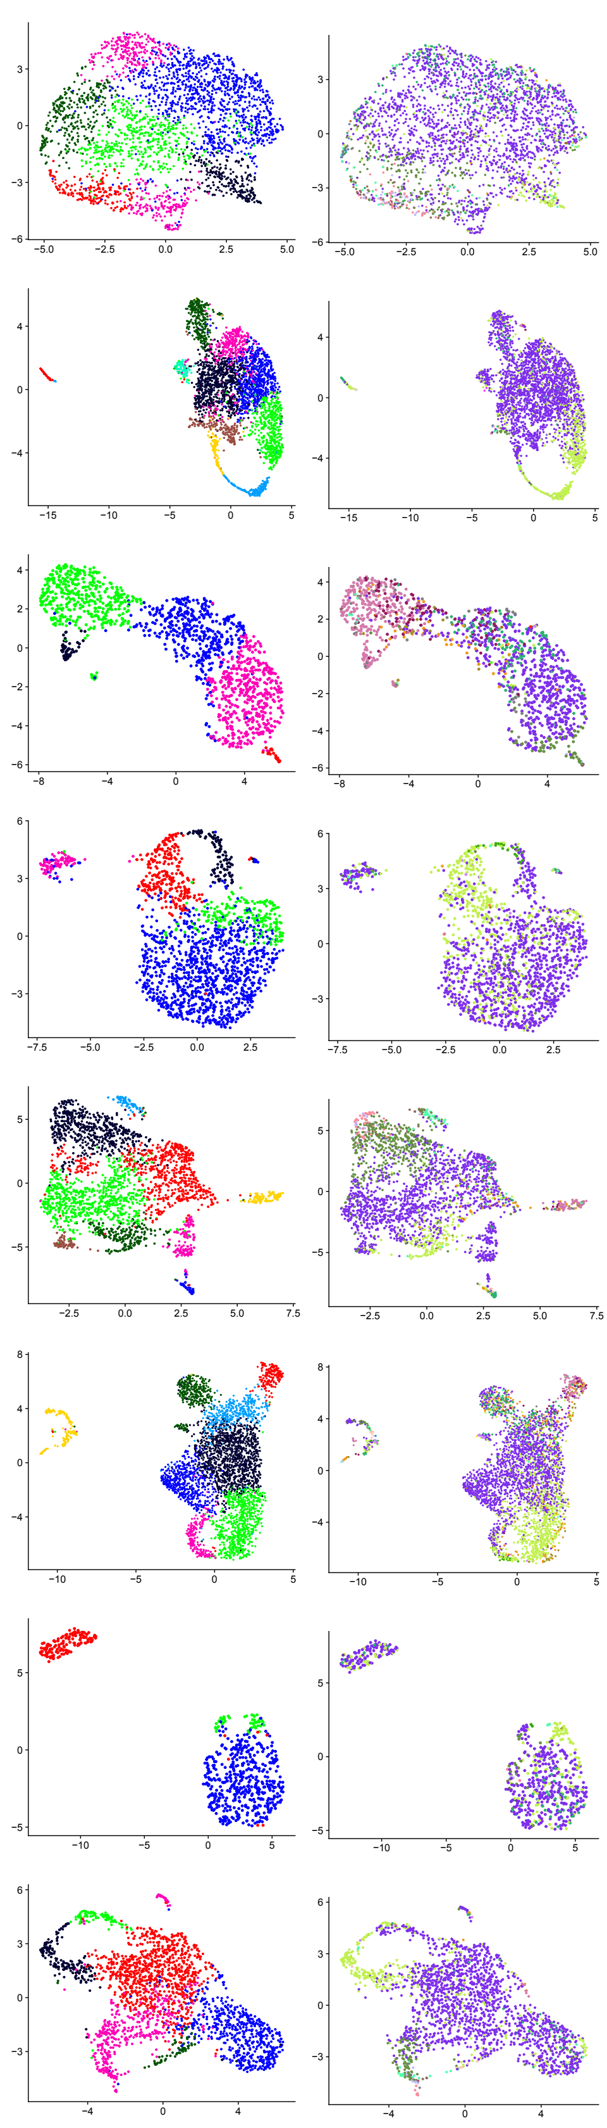

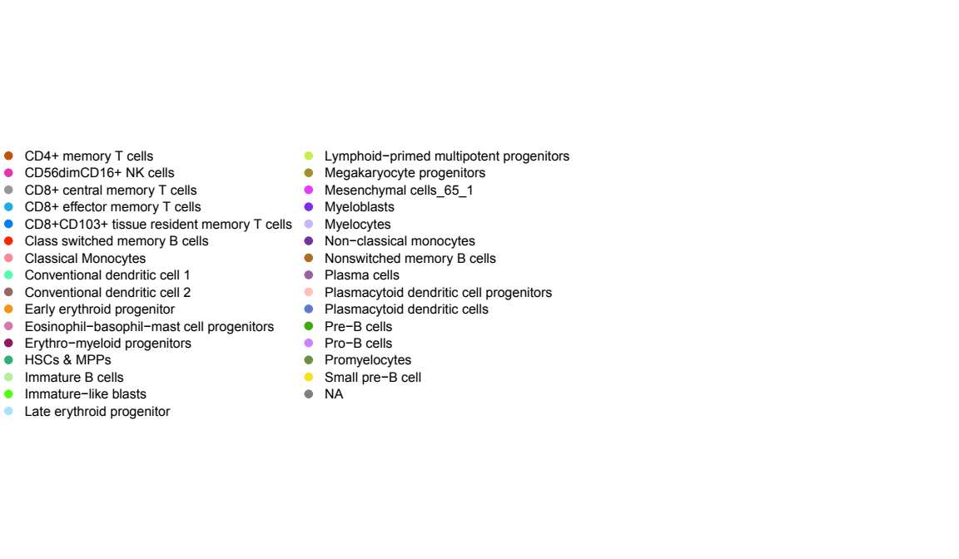
Sample Data
AML7 (Dx)
AML14 (Dx)
Up to 10 clusters
No clear differences Dx vs REL
Myeloblasts are predominant
LPMPs and promyelocites localized in distinctive clusters in all samples
Higher variance of ribosomal genes in REL samples and in AML16
AML10 (REL)
AML15 (REL)
AML9 (Dx)
AML16 (Dx)
AML13 (REL)
AML17 (REL)
Cluster
Healthy BM cell type projection
Figure 5: Sample clustering (Left) and healthy BM cell type (Right) in UMAP.

Slide 9
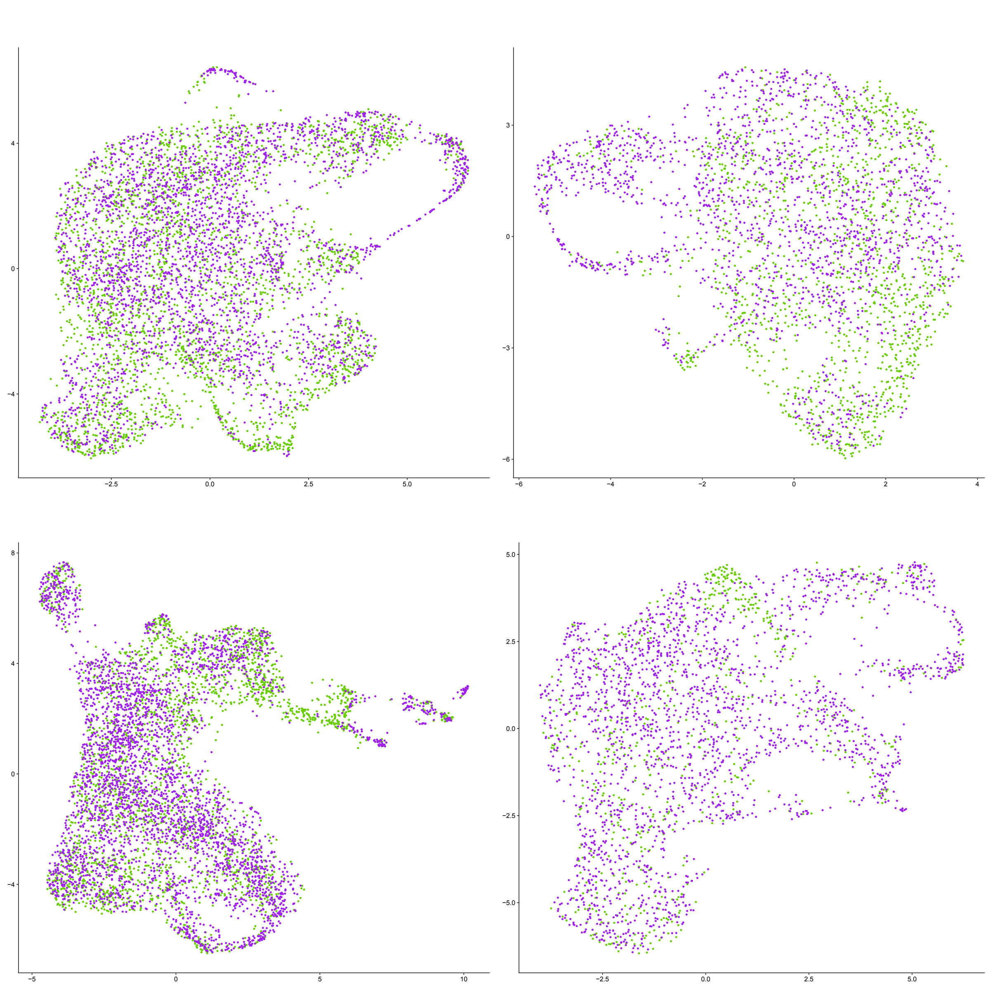
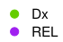
Patient data
AML7.10
AML9.13
Homogeneous distribution of samples
Areas with a higher proportion of Dx or REL cells
AML14.15
AML16.17
AML16.17
Figure 6: Patient data integration, distribution of Dx and REL cells in UMAP.

Slide 10
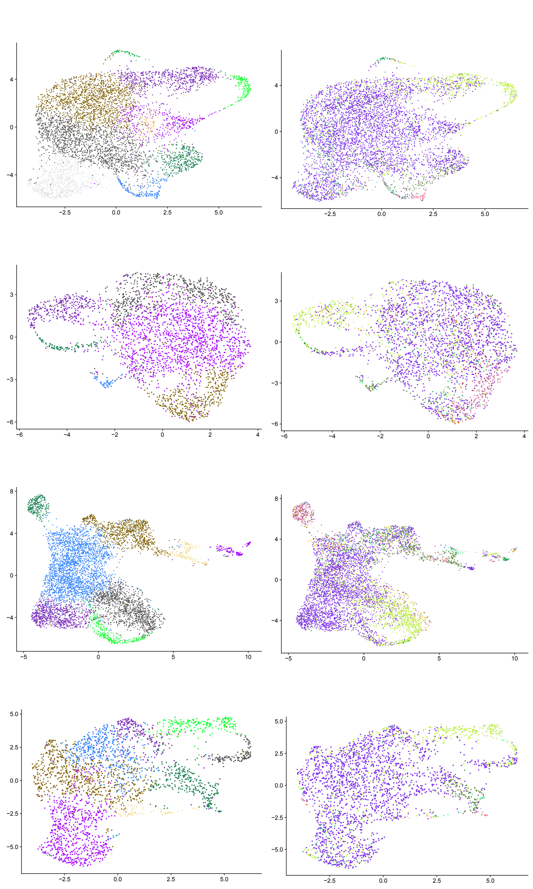
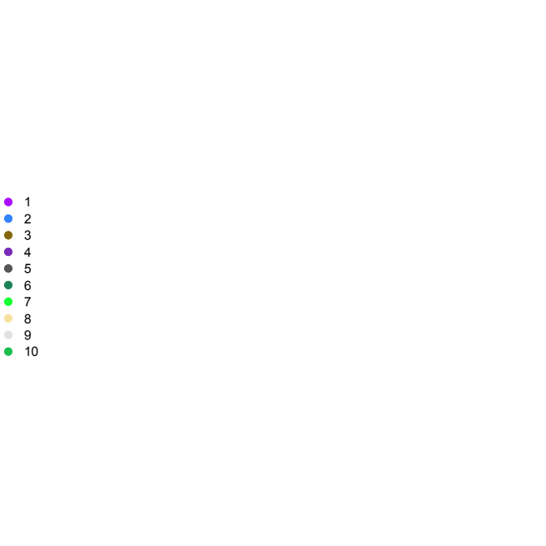
Patient data
AML7.10
Homogeneous distribution of samples
Areas with a higher proportion of Dx or REL cells
Up to 10 Clusters
Similar cell type distribution:
Myeloblasts at the main body
LPMPs in distinctive clusters, loop-like shape
AML9.13
Cluster
Healthy BM cell type projection
AML14.15
AML16.17
Figure 7: Patient-paired data clustering after integration (Left) and healthy BM cell types projections (Right) in UMAP plots.

Slide 11
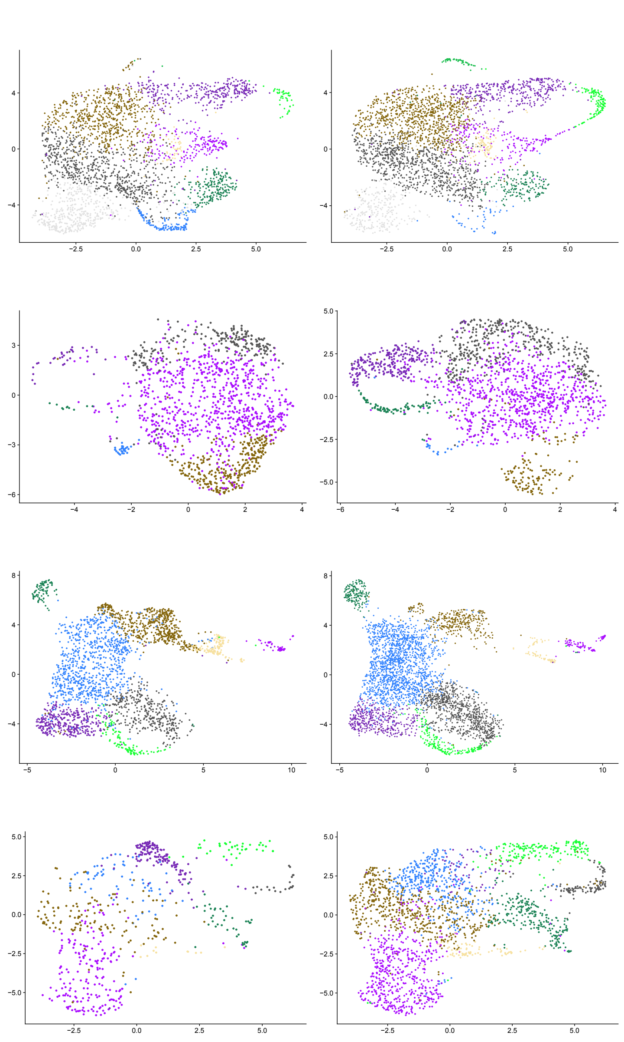
Dx
REL
Patient data
AML7.10
Homogeneous distribution of samples
Areas with a higher proportion of Dx or REL cells
Up to 10 Clusters
Similar projection distribution:
Myeloblasts at the main body
LPMPs in distinctive clusters, loop-like shape
Clusters in the loop-like shape are increased at REL
By ORA, enriched in:
Cytoskeleton function and movement,
Cell cycle checkpoints,
DNA repair and/or
Drug resistance
AML9.13
Cluster
AML14.15
AML16.17
Figure 8: Changes in cluster size between Dx (Left) and REL (Right).

Slide 12
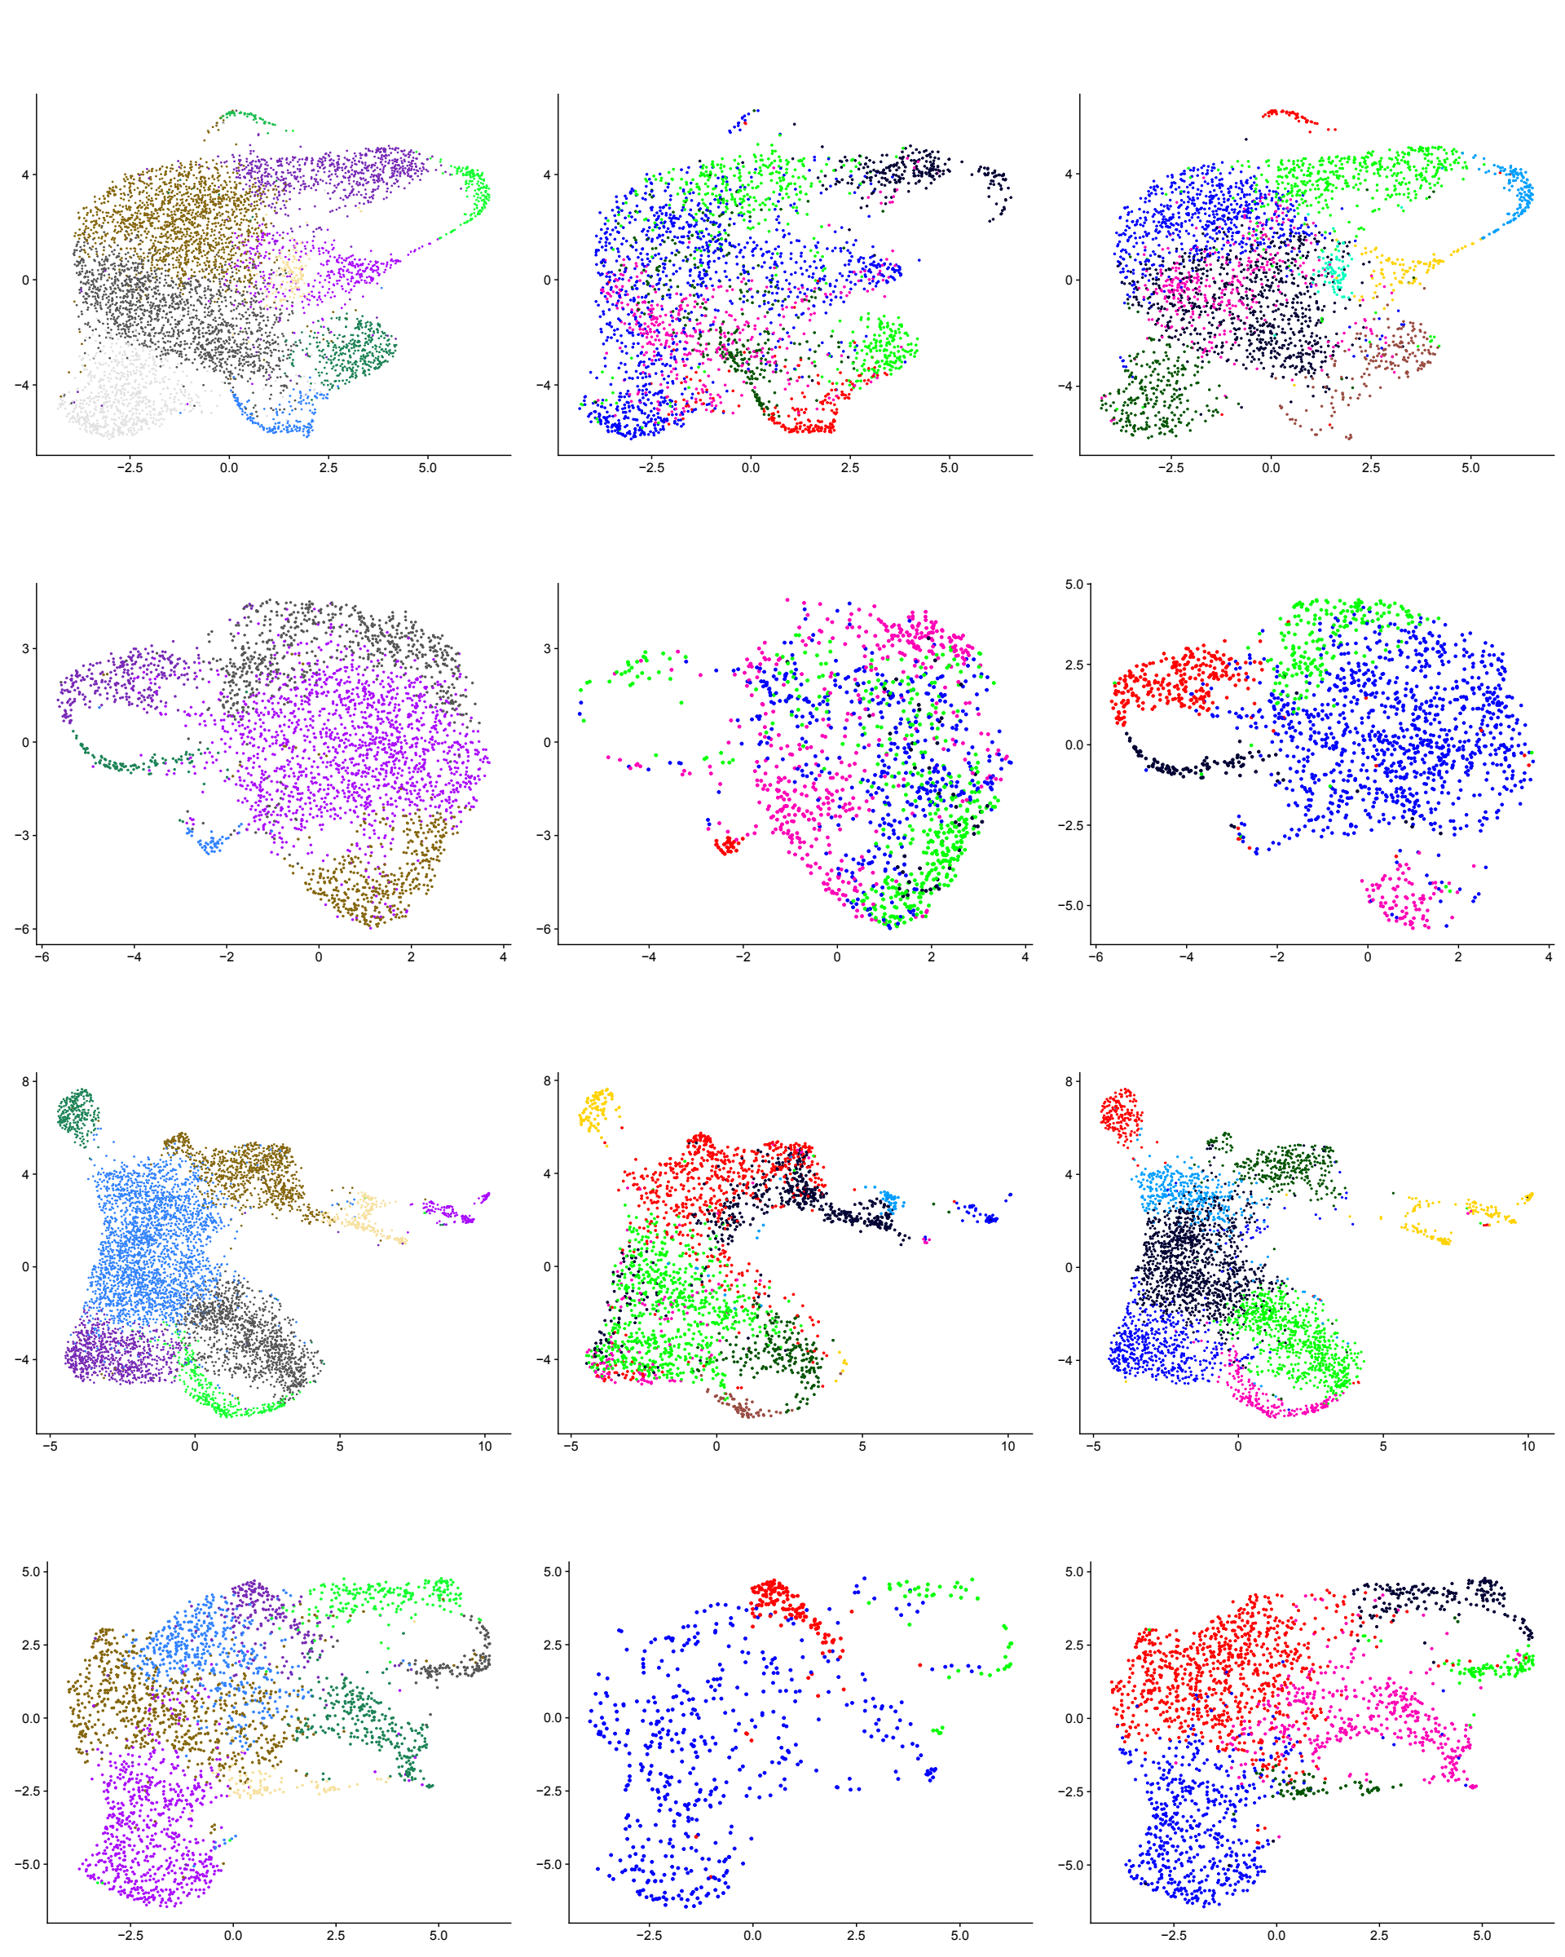
Paired
Dx
REL
Patient data
AML7.10
Homogeneous distribution of samples
Areas with a higher proportion of Dx or REL cells
Up to 10 Clusters
Similar projection distribution:
Myeloblasts at the main body
LPMPs in distinctive clusters, loop-like shape
Clusters in the loop-like shape are increased at REL
By ORA, enriched in:
Cytoskeleton function and movement,
Cell cycle checkpoints,
DNA repair and/or
Drug resistance
Functions replicated in the sample clusters
Paired data cluster
AML9.13
Sample cluster
AML14.15
AML16.17

Slide 13
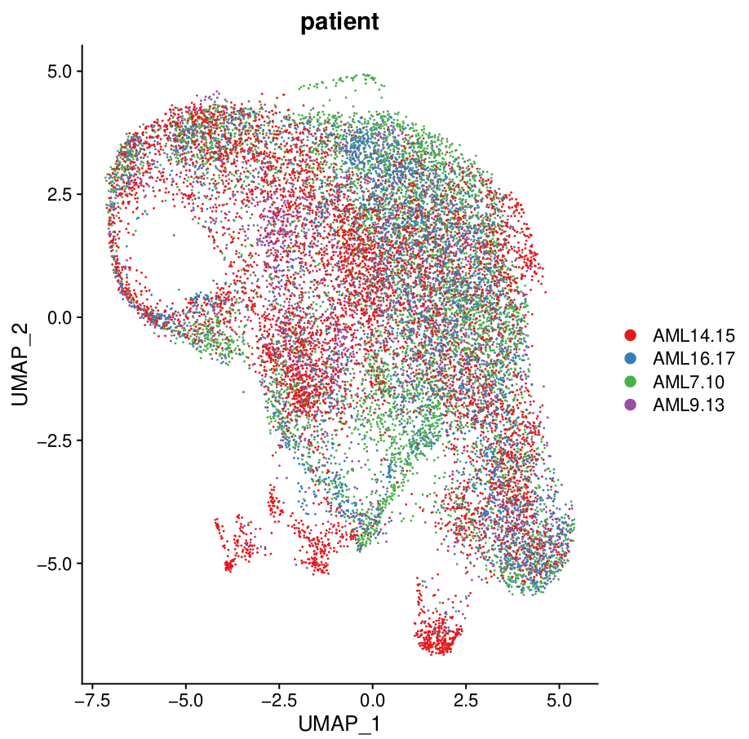
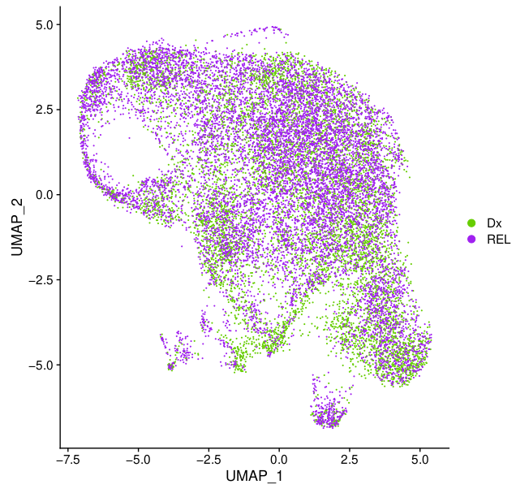
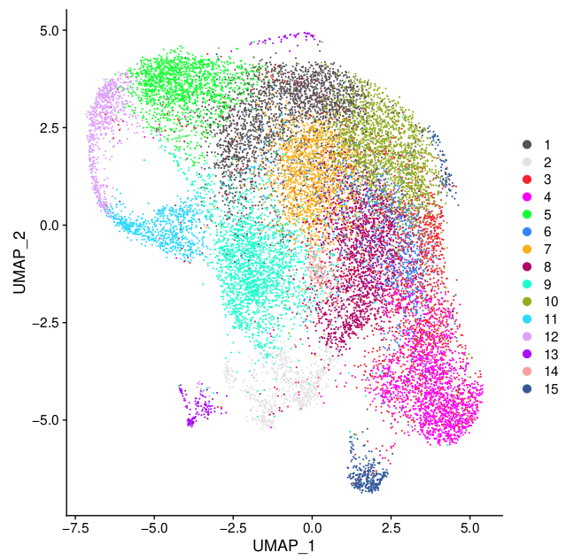
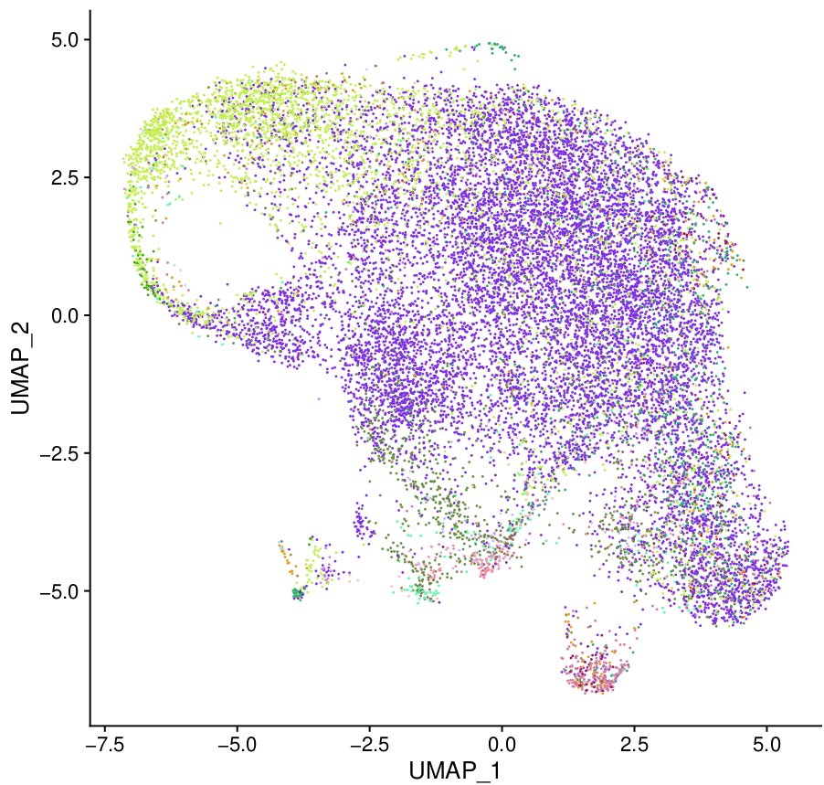
Patient
Full Integration data
A)
Patient
B)
Condition
Patient cells and condition (Dx vs REL) homogeneously distributed
15 Clusters
LPMPs localized in the loop-like shape clusters
C)
Clusters
D)
Projections
Healthy BM cell type projection
Figure 10: Whole data integration in UMAP plots.

Slide 14
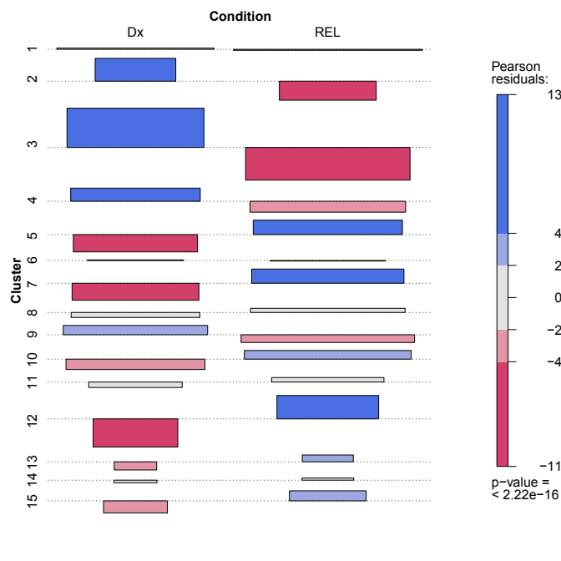
Full Integration data
Patient cells and condition (Dx vs REL) homogeneously distributed
15 Clusters
LPMPs localized in the loop-like shape clusters
Clusters 5, 7, 10 and 12 significantly increased at REL
Figure 11: Association plot between the clusters and condition.
Red color indicates negative Pearson residuals smaller than 2, while blue colors indicate positive Pearson residuals bigger than 2. Values below or above 4 is considered an statistically significant (p < 0.5).The rectangle area is proportional to the difference in observed and expected frequencies.

Slide 15
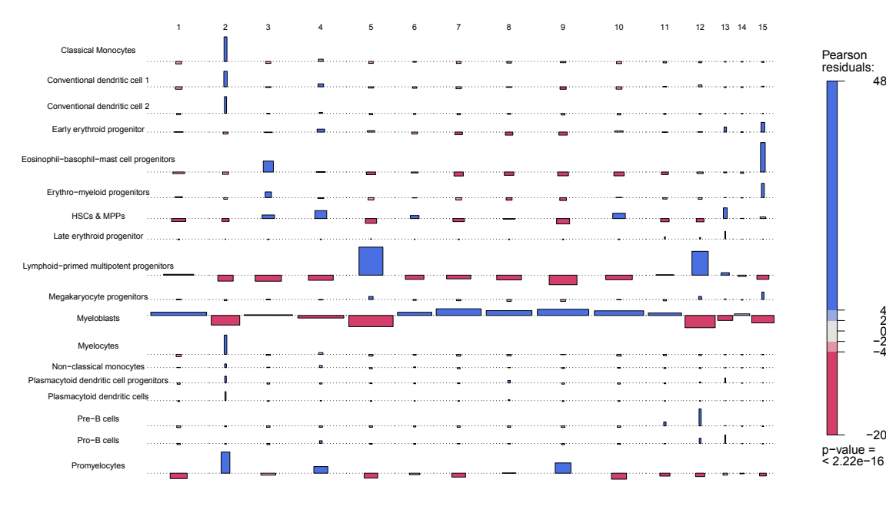
Full Integration data
Patient cells and condition (Dx vs REL) homogeneously distributed
15 Clusters
LPMPs localized in the loop-like shape clusters
Clusters 5, 7, 10 and 12 significantly increased at REL
Cluster 5 and 12: LPMPs
Cluster 7: Myeloblasts
Cluster 10: HSC & MPP
Figure 12: Association plot of clusters and healthy BM cell type projections.
Only the cell types accounting for at least 0.5% of the total projected cells in the dataset have been
analyzed.

Slide 16
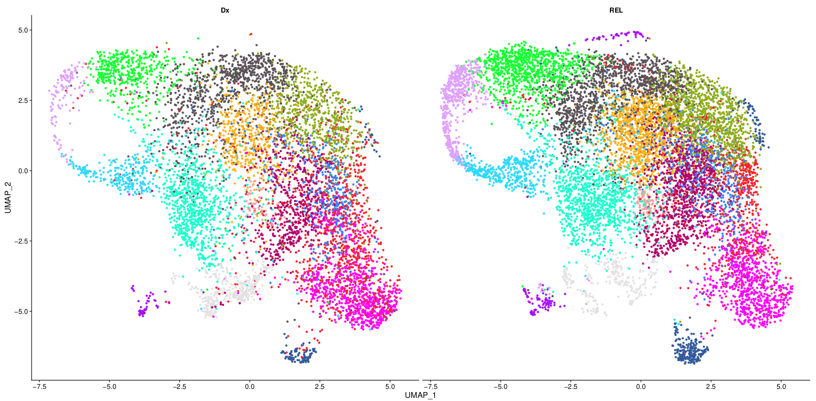
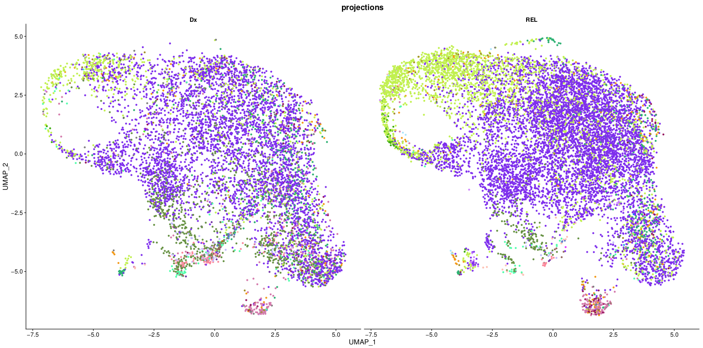
Full Integration data
Dx
REL
Cluster
Patient cells and condition (Dx vs REL) homogeneously distributed
15 Clusters
LPMPs localized in the loop-like shape clusters
Clusters 5, 7, 10 and 12 significantly increased at REL
Cluster 5 and 12: LPMPs
Cluster 7: Myeloblasts
Cluster 10: HSC & MPP
Healthy BM cell type projection

Slide 17
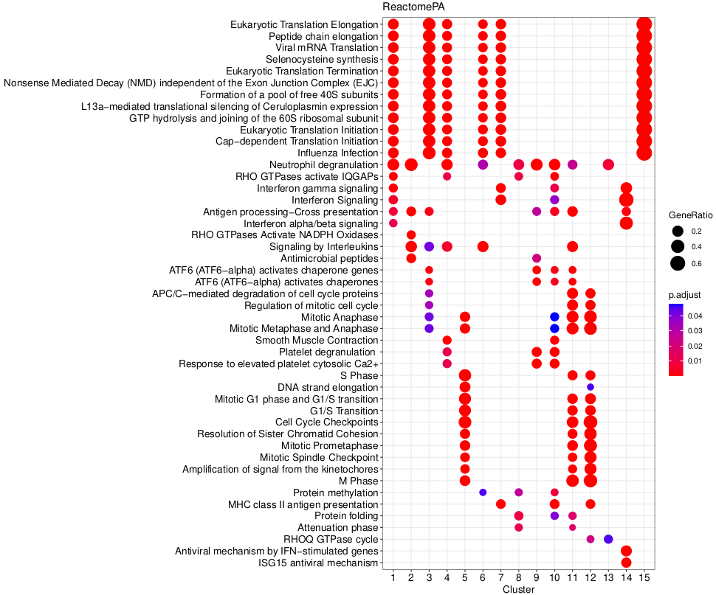
Full Integration data
Patient cells and condition (Dx vs REL) homogeneously distributed
15 Clusters
LPMPs localized in the loop-like shape clusters
Clusters 5, 7, 10 and 12 significantly increased at REL
Cluster 5 and 12: LPMPs
Cluster 7: Myeloblasts
Cluster 10: HSC & MPP
By ORA, enrichment conserved (Dx and REL) in:
TP53 function (Cluster 5, 11, 12),
Cell cycle checkpoints and regulation (Cluster 5,11, 12),
Drug resistance (Cluster 5, 10, 12)
Figure 14: ORA analysis in Reactome database in the whole integration data set.
Here, using FindConservedMarkers function in Seurat, the top 100 DEGs for each cluster were used
that were differentially expressed in Dx and REL cells. The first 5 enriched pathways (ordered by p-
value) for each cluster are shown

Slide 18
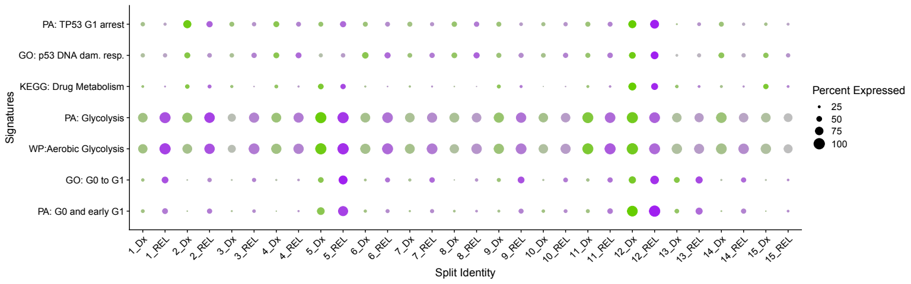
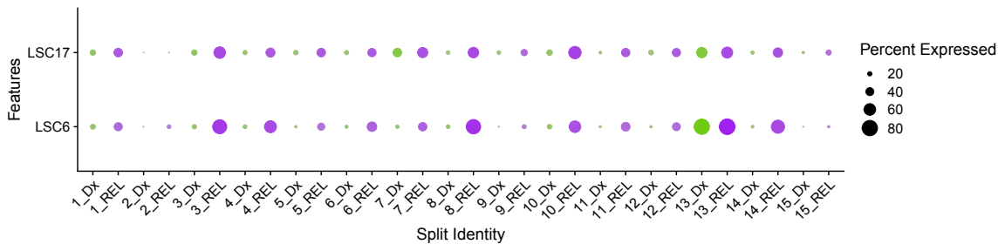
Full Integration data
Clusters 5, 7, 10 and 12 significantly increased at REL
Cluster 5 and 12: LPMPs
Cluster 7: Myeloblasts
Cluster 10: HSC & MPP
By ORA, enrichment conserved (Dx and REL) in:
TP53 function (Cluster 5, 11, 12),
Cell cycle (Cluster 5,11, 12),
Drug resistance (Cluster 5, 10, 12)
P53, Drug metabolism and Quiescence signatures enriched in clusters 5 and 12
LSC17 and LSC6 higher in REL

Slide 19
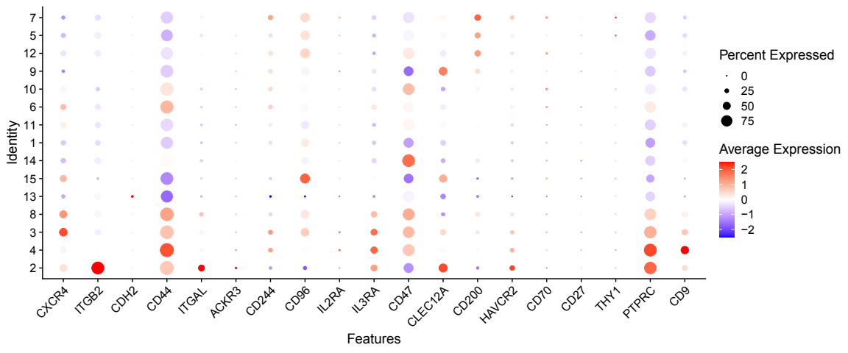
Full Integration data
Clusters 5, 7, 10 and 12 significantly increased at REL
Cluster 5 and 12: LPMPs
Cluster 7: Myeloblasts
Cluster 10: HSC & MPP
By ORA, enrichment conserved (Dx and REL) in:
TP53 function (Cluster 5, 11, 12),
Cell cycle (Cluster 5,11, 12),
Drug resistance (Cluster 5, 10, 12)
P53, Drug metabolism and Quiescence signatures enriched in clusters 5 and 12
LSC17 and LSC6 higher in REL
Selected clusters express lower LSC markers
But highest expression of CD200, high in CD96
Figure 18: LSC marker expression.
Markers include functions in BM niche integration (CXCR4, ITGB2, CDH2, ITGAL, ACKR3, CD9),
immune modulation (CD244, CD96, IL2RA, ILR3A, CD47, CLEC12A, CD200, HAVCR2, CD70,
CD27, THY1) and cell signaling (PTPRC, CD44). Clusters are hierarchically ordered.

Slide 20
Analyzed the transcriptional landscape changes of the AML CD34⁺/CD38⁻ cell population between Dx and REL
Data obtained by Dr. Pablo Menendez’s group
Identified a subset of cells with distinctive characteristics
Present in all patients
Increased at REL
Enriched in LPMPs
Enrichment of functions related with LSCs
Future work:
Validation of results
Cell cycle scoring and Ribosomal gene % for normalization
Trajectory analysis
Subclustering

Slide 21
Master Thesis
MSc in Bioinformatics and Biostatistics
scRNAseq Analysis of AML CD34⁺/CD38⁻ population with Diagnosis and Relapse paired data
Author: Joseba Elizazu Perez
Director: Juan Luís Trincado Alonso
6/06/22

